Slide 1



Title –
Design of IOT Architecture for
Battery Charging Management Technology
Major project 1st Review Presentation
Presented by
Jagadeesh_(AP2312210002)
under the Esteemed guidance of
Dr. Sujith Kalluri Ph.D
Associate Professor
School of Engineering and Sciences (SEAS)
Department of Electronics and Communication Engineering
SRM University, Andhra Pradesh (SRM AP)

Slide 2

Outline
Proposed concept & Methodology

Slide 3
Battery Swapping & Fast charging Technology
Commercial usage more demand – Rental vehicles
Less time we can refill the battery

Slide 4
Importance of IOT Architecture
Real time data communication wirelessly. -
Advance Power demand Estimation – elimination of power demand
Grid to ESS – bi-directional conversion – estimation
Load demand hourly
End user notification and real time updates
Battery Swapping Station monitoring
  - Very cell balancing monitoring

Slide 5
Battery Swapping
MPPT
DC – DC
Buck – boost converter
ESS
Energy Storage system
Power - Solar
Type - DC
Bidirectional converter
Grid
Central control monitoring
Swapping Battery Storage
Swapping Battery Storage
Swapping Battery Storage

Slide 6
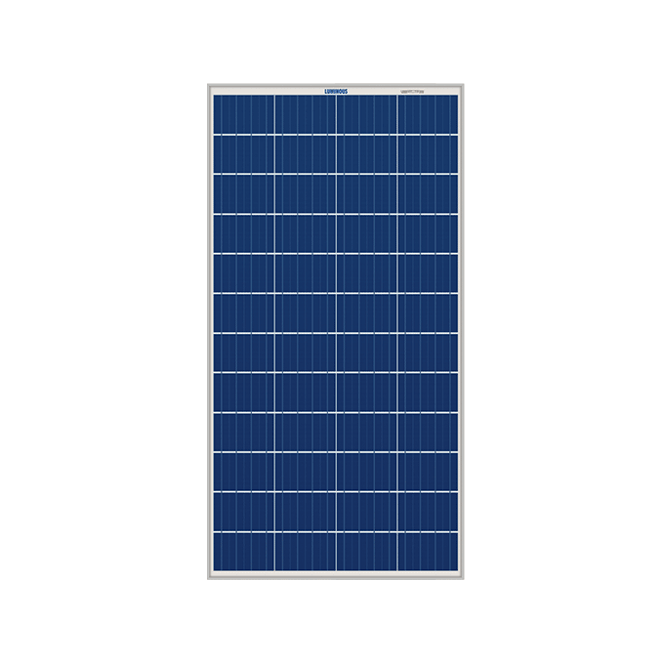
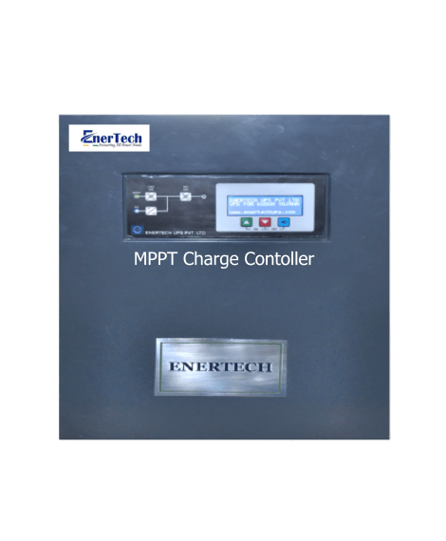
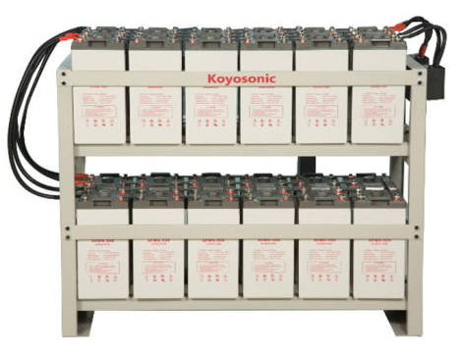

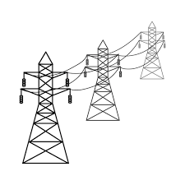



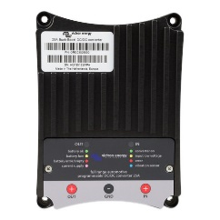




Bi directional converter
Grid
MPPT
Central Control Monitoring
Solar
ESS
Buck – Boost converter
Cloud
Fast Charging
Swapping
User Interface

Slide 7
Monitoring Parameters
Central Control Monitoring
User Interface

Slide 8
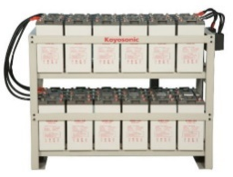
Monitoring Parameters
Central Control Monitoring

Slide 9
Monitoring Parameters – Topology - Hardware
Voltage Output, Current Output, Power Generation
Temperature, Light Intensity, Humidity, Fault Detection
Sensor Layer
Microcontroller Layer
Communication Layer
Cloud Server Layer
User Interface Layer
ESP32, Arduino Uno
Wireless
AWS – IOT core, lambda function, Data visualization
Solar Pannel
WEB, or APP

Slide 10
Monitoring Parameters – Topology - Hardware
Voltage, Current, Temperature, Battery Health, Charge/Discharge Cycles, Energy Input/Output, Fault Detection
Sensor Layer
BMS Layer
IoT Gateway Layer
Cloud Server Layer
User Interface Layer
SOC, SOH, DOD, SOP
Bridge between controller and Cloud
Stores data and runs analytics for insights
ESS
WEB, or APP

Slide 11
Monitoring Parameters – Topology - Hardware
Voltage, Current, Frequency, Power Factor, Harmonics, Load, Transformer Health, Fault Detection, Grid Stability, Renewable Energy Integration
Sensor Layer
Data Acquisition Layer
IoT Gateway Layer
Cloud Server Layer
User Interface Layer
PLC or RTU collects and processes data from sensors.
Wireless
AWS – IOT core, lambda function, Data visualization
Grid
WEB, or APP

Slide 12
Monitoring Parameters – Topology - Hardware
State of Charge (SoC), Battery Voltage, Battery Current
Battery Temperature, Battery Health, Swapping Time, Fault Detection
Inventory Management, User Identification, Energy Usage
Sensor Layer
Processing Unit Layer
IoT Gateway Layer
Cloud Server Layer
User Interface Layer
Microcontroller or PLC processes data and manages the swapping process.
Bridge between controller and Cloud
Stores data and runs analytics for insights
Battery Swapping
WEB, or APP

Slide 13
Monitoring Parameters – Topology - Hardware
Charging Status, Charging Power, Charging Time, Energy Delivered
Charging Efficiency, User Identification: Authenticates users, Fault Detection, Utilization Rate, Station Availability, Location Tracking
Sensor Layer
Data Acquisition Layer
IoT Gateway Layer
Cloud Server Layer
User Interface Layer
Charging station controller collects and processes sensor data.
Bridge between controller and Cloud
Stores data and runs analytics for insights
DC fast charging
WEB, or APP

Slide 14
Monitoring Parameters – Topology - Hardware
Charging Status, Charging Power, Charging Time, Energy Delivered
Charging Efficiency, User Identification: Authenticates users, Fault Detection, Utilization Rate, Station Availability, Location Tracking
Device Layer
Data Ingestion Layer
Processing Layer
Cloud Server Layer
User Interface Layer
Charging station controller collects and processes sensor data.
Bridge between controller and Cloud
Stores data and runs analytics for insights
WEB, or APP
Cloud and user interface

Slide 15

User Interface Application Layer
IOT Architecture for Battery charging management
Application Layer
Presentation Layer
Session Layer
Transport Layer
Network Layer
Data Link Layer
Physical Layer
Cloud Server Layer Data storage
Communication Layer IoT Gateway Layer Processing Layer
Microcontroller Layer BMS Layer Data Acquisition Layer Processing Unit Layer
Sensor Layer

Slide 16
End to End Flow
Start
Check for the power source
Solar
ESS
Grid
PCC – Point of Common Coupling
Solar – ON → ESS Charge → Grid OFF → Load ON
Solar – ON → ESS >80% → [Grid DC- AC] ON → Load ON
Solar – OFF → ESS ON → Grid OFF → Load ON
Solar – OFF → ESS <20% → [Grid DC- AC] ON → Load ON
Battery Swapping Station
DC Fast Charging Station

Slide 17
PCC integration and Automation
Start
Grid Off
IF
Solar Available
IF
Solar Not Available
Grid Off
ESS ON
ESS
< 20%
Load On
ESS Charging > 80%
Load On
Power to Grid
Grid
Power
ON
Load On
No Load
ESS Charging
Still Solar Available
Cycle Continuous

Slide 18
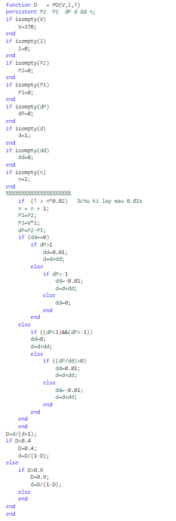
Algorithms
Solar MPPT
Initialize Variables Check if input parameters VV (voltage), II (current), and TT (time) are empty.
Set default values if any parameter is empty:V=370V=370
I=0I=0, P2=0P2=0, P1=0P1=0, dP=0dP=0, d=1d=1, dd=0dd=0, n=1n=1
Check Time ConditionIf T>n∗0.02T>n∗0.02:Increment nn by 1
Update previous power values:P1=P2P1=P2
P2=V∗IP2=V∗I (Calculate current power)
Calculate Power ChangeCalculate change in power:dP=P2−P1dP=P2−P1
Adjust Duty Cycle Based on Power ChangeIf dd==0dd==0:If dP>1dP>1:Set dd=0.01dd=0.01
Increment dd by dddd
Else if dP<−1dP<−1:Set dd=−0.01dd=−0.01
Increment dd by dddd
Else:Set dd=0dd=0
If Duty Cycle Adjustment is ActiveIf (dP<1)&&(dP>-1):Set dd=0
Increment d by dd
Else:If (dP/dd)>0:Set dd=0.01
Increment d by dd
Else:Set dd=-0.01
Increment d by dd
Calculate Duty Cycle DCalculate duty cycle:D=d/(d+1)
Limit Duty Cycle ValuesIf D<0.4:Set D=0.4
Update duty cycle:d=D/(1-D)
Else if D>0.9:Set D=0.9
Update duty cycle:d=D/(1-D)
End of Algorithm Return the final value of duty cycle D.

Slide 19
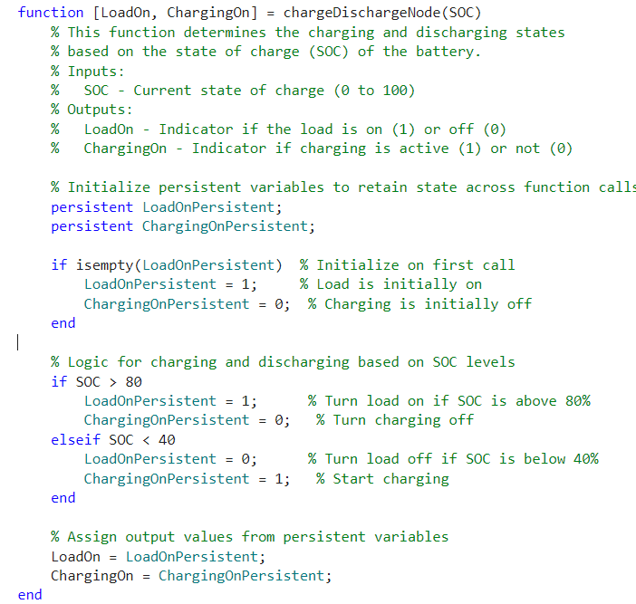
Algorithms
Battery Swapping Station -- Charging
Initialize Persistent Variables:
  Check if LoadOnPersistent and ChargingOnPersistent are empty.
  If empty, set:
    LoadOnPersistent = 1 (Load is initially ON)
    ChargingOnPersistent = 0 (Charging is initially OFF)
Check State of Charge (SOC):
  If SOC > 80:
    Set LoadOnPersistent = 1 (Turn load ON)
    Set ChargingOnPersistent = 0 (Turn charging OFF)
  Else if SOC < 40:
    Set LoadOnPersistent = 0 (Turn load OFF)
    Set ChargingOnPersistent = 1 (Start charging)
Assign Output Values:
  Assign output values:
    LoadOn = LoadOnPersistent
    ChargingOn = ChargingOnPersistent
Return Outputs:
  Return the values of LoadOn and ChargingOn.

Slide 20
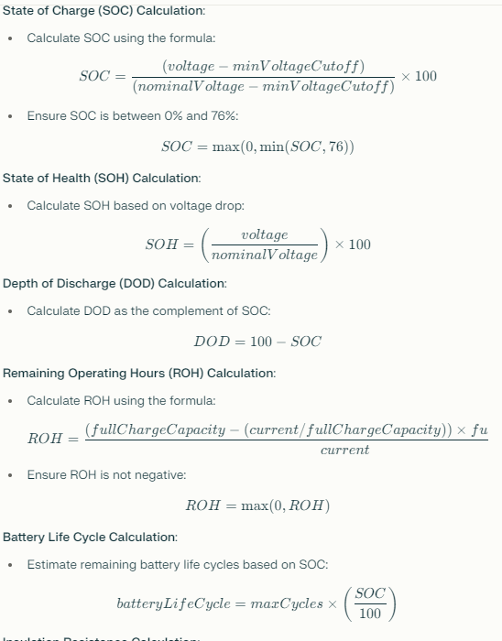
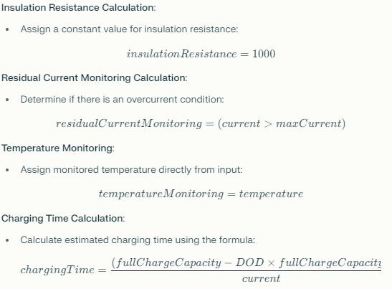
Algorithms
Car Charging control calculation
Input Parameters:
  Receive input values:
    voltage: Voltage of the battery in volts.
    current: Current flowing into the battery in amperes.
    temperature: Temperature of the battery in degrees Celsius.
Define Constants:
  Set constants for calculations:
    nominalVoltage = 12 (Nominal voltage of the battery in volts).
    maxCurrent = 100 (Maximum current rating in amperes).
    fullChargeCapacity = 100 (Full charge capacity in Ah).
    minVoltageCutoff = 10.5 (Minimum voltage cutoff for the battery in volts).
    maxCycles = 500 (Estimated maximum cycles for the battery life).
Voltage Level Calculation:
  Assign voltageLevel = voltage.
Current Level Calculation:
  Assign currentLevel = current.
  Calculation
Output Parameters:
  Return all calculated parameters:
    voltageLevel currentLevel
    SOC SOH DOD ROH
    batteryLifeCycle insulationResistance
    residualCurrentMonitoring temperatureMonitoring
    chargingTime

Slide 21








Slide 22

Thankyou

